Slide 1


CYCLISTIC BIKE SHARE ANALYSIS CASE STUDY
Prepared by : Aruzhan Karimzhanova

Slide 2
All the data visualizations are made in R
You can reproduce these visualization by refering to my R markdown document: docs/Bike data.Rmd
In the end of this PowerPoint you will find my analysis summary and recommendations

Slide 3
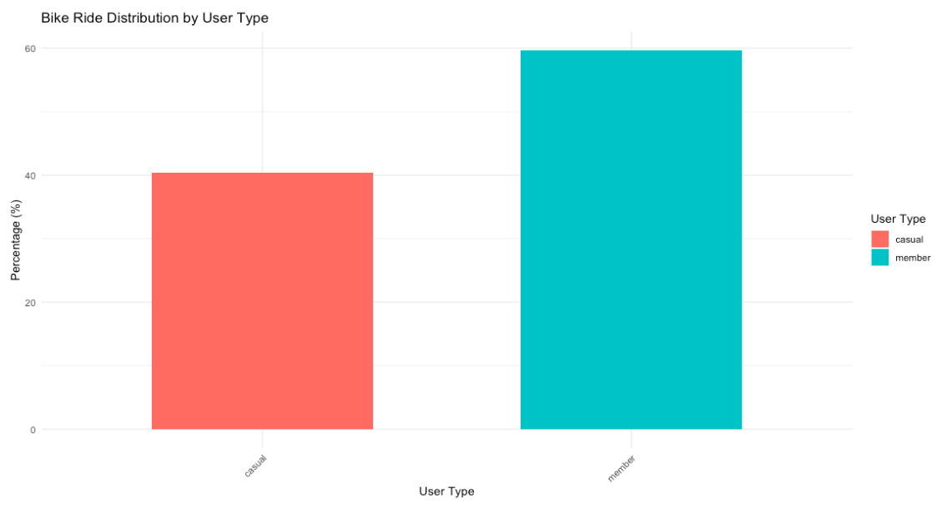
Bike Ride Distribution by User Type
Key insight:
59.7% of riders are members, and 40.3% of riders are casual users.

Slide 4
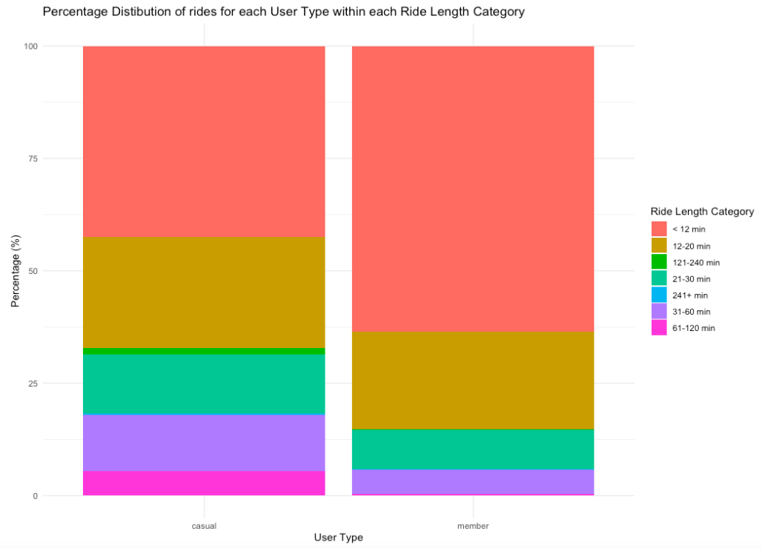
Percentage distribution of rides for each User Type within each Ride Length Category
Key insights:
For both user types the majority of rides fall into first two categories: "<12 min" and "12-20 min".
42.44% and 24.67% of casual users ride a bike for less than 12 minutes, and between 12 and 20 minutes, respectively.
63.57% and 21.70% of member users ride a bike for less than 12 minutes, and between 12 and 20 minutes, respectively.

Slide 5
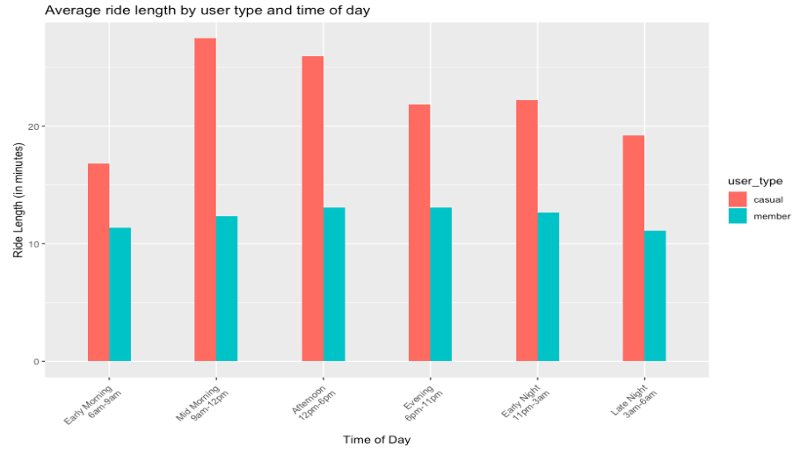
Average ride length by user type and time of day
Key insights:
Ride length for casual steadier peaks mid morning through afternoon
Ride length for member riders remains steadier throughout the day

Slide 6
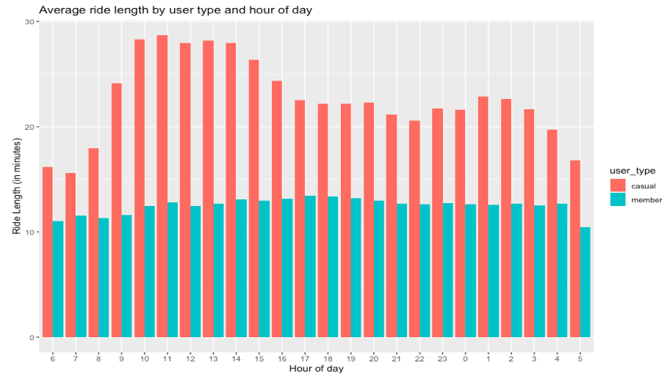
Average ride length by user type and hour of day
Key insight:
Casual riders on average ride longer than member riders (between 25 and 30 min), peaking between 10AM - 2PM

Slide 7
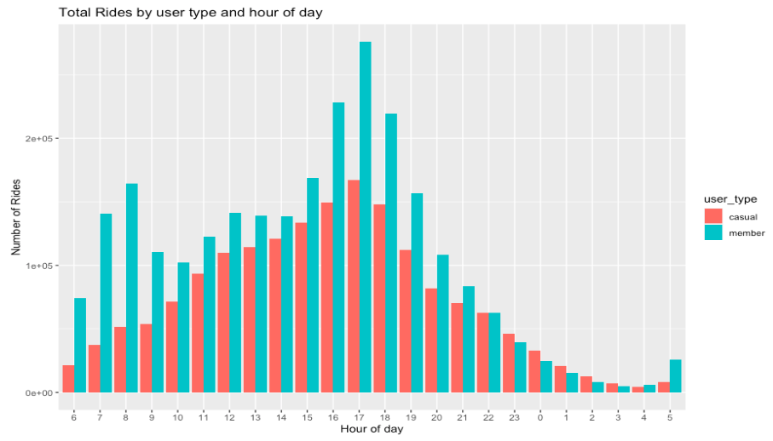
Total rides by user type and hour of day
Key insights:
For members total rides peak during morning (7-8am) and evening (4-6 pm)
Casual rides also peak from 4pm to 6pm

Slide 8
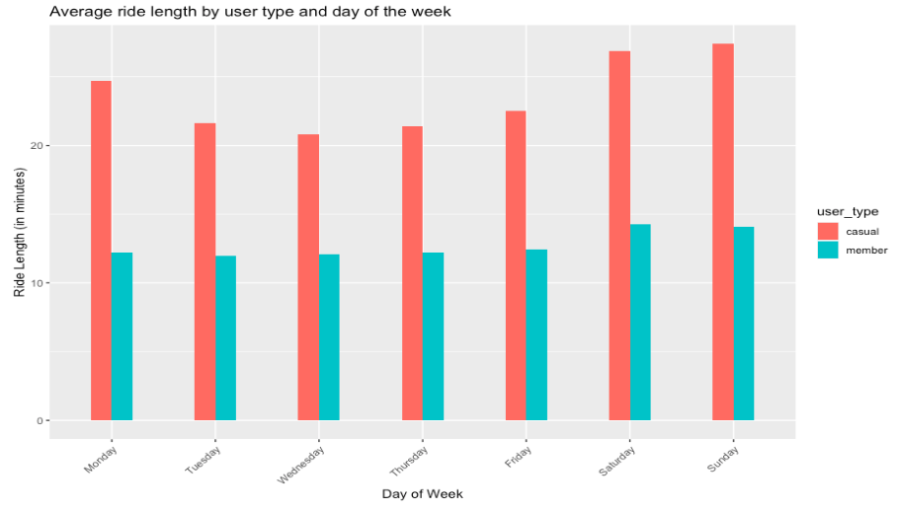
Average ride length by user type and day of the week
Key insight:
Both users take longer rides on the weekend (Saturday, Sunday)

Slide 9
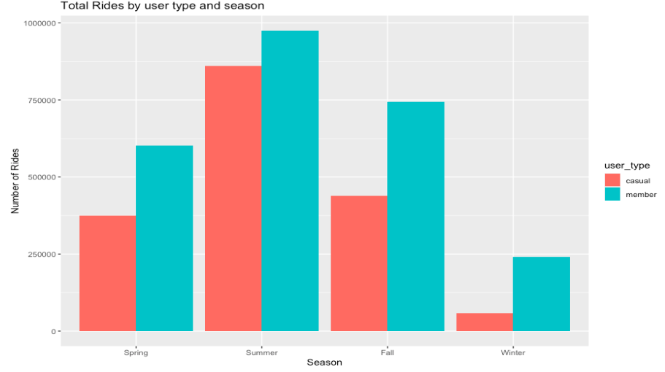
Total Rides by user type and season
Key insights:
In each season we see more member rides.
Both riders peak in summer and decline in winter

Slide 10
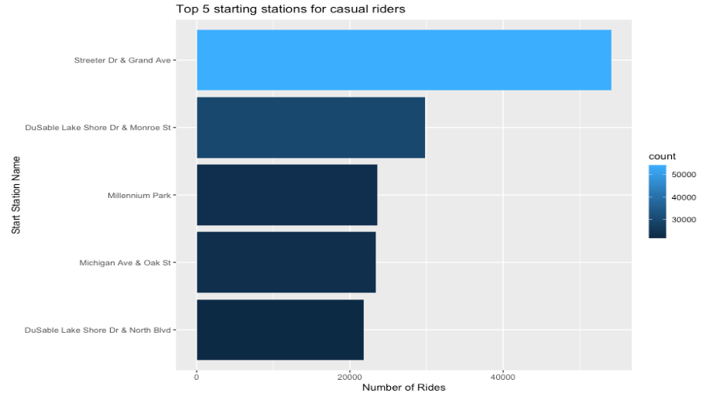
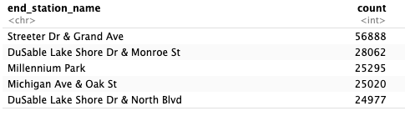
Top 5 ending stations for casual riders

Slide 11
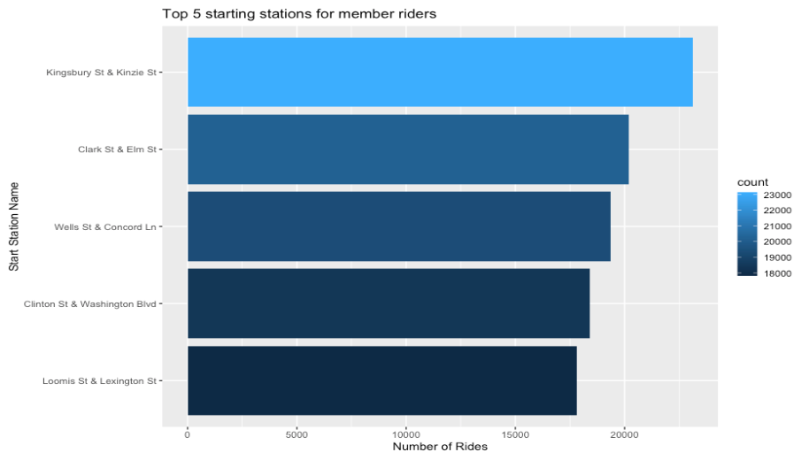
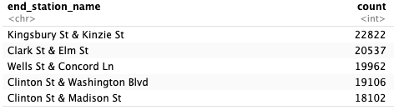
Top 5 ending stations for member riders

Slide 12
Key insights:
The top 5 starting and ending stations are the same for casual riders
The most popular starting station is Streeter Dr & Grand Ave, which is located near the park in Chicago.
The top 5 starting and ending stations are the same for member riders except for one station
The top starting and ending station for member riders is Ellis Ave & 60th St which is situated within the University of Chicago

Slide 13
Share:
Summary of key findings:
In general, 59.7% of riders are members, and 40.3% of riders are casual users.
On average, casual riders ride a bike twice longer than member riders (24.07 min and 12.67 min, respectively)
For both user types the majority of rides fall into first two categories: "<12 min" and "12-20 min“
Ride length for casual riders peaks mid morning through afternoon, especially between 10AM - 2PM, while for members its more consistent
Members take more rides during morning (7-8am) and evening (4-6 pm) , casual total number of rides also peak from 4pm to 6pm
Both users take longer rides on weekend
For both user types rides peak in summer and decline in winter

Slide 14
Additional data analysis to consider:
This project uses a limited public dataset due to the protection of user privacy. Ideally, the marketing team would use the full dataset to carry out the following additional analysis:
Discover which casual riders are locals and focus on their riding habits
Determine how well and conveniently bike stations are situated
Break out your single ride and day pass riders
Analyze the number of trips and length of trips that local casual riders take
Take a closer look at the riding habits of your member riders
Number of trips, length of trip, who's riding multiple times a day? and where are they going?
In what ways does the surrounding landscape impact the riding experience of member riders and casual riders in the area?
Do they live in a dense population?
Are there major employers around?
Are there educational or medical institutions nearby?
Get a sense of whether the surrounding infrastructure promotes riding to work, riding to school, riding to grocery stores ,eateries, shopping, coffee shops, social gatherings.

Slide 15
Act:
Recommendations:
For the marketing team to design a new marketing strategy to convert casual riders into annual members, they need to consider these recommendations:
Market around pricing for the peak hours, days of the week and season:
Offer special rates, membership subscriptions, or loyalty program for mid morning through afternoon hours (peak hours for casual riders), weekends (Saturday and Sunday), and for the summer months.
Consider which bike stations are used the most and in what areas are they situated:
Members take the most rides during morning and evening hours, and the most popular start station is situated near the University of Chicago, which suggest that membership is used the most by university students and staff. It would be beneficial to start a marketing campaign targeting this area. For example, offer a reward for recruiting a friend to ride to work or school.
Market to people whose home area and daily travel needs likely align well with your bike system. Focusing on dense and walkable areas, partnering with schools and companies.
Offer special discounts, day passes around the places of leisure, nature and tourist attractions, as the analysis suggests that casual users are more prone to take a bike near parks, lakes, beaches etc.
Use digital media and smart advertisements:
Use social media to showcase member riders who are already using bikes to go to work, school, the gym, to meet friends.
Raise awareness of the ease of use, affordability, accessibility, green options and common uses for bikes rides.

